Slide 1

S/W 프로젝트

Slide 2

차주 계획
EVENT FIX

Slide 3
ERROR 2002: Can't connect to local Mysql server through socket '/tmp/mysql.sock’ (2)

Slide 4
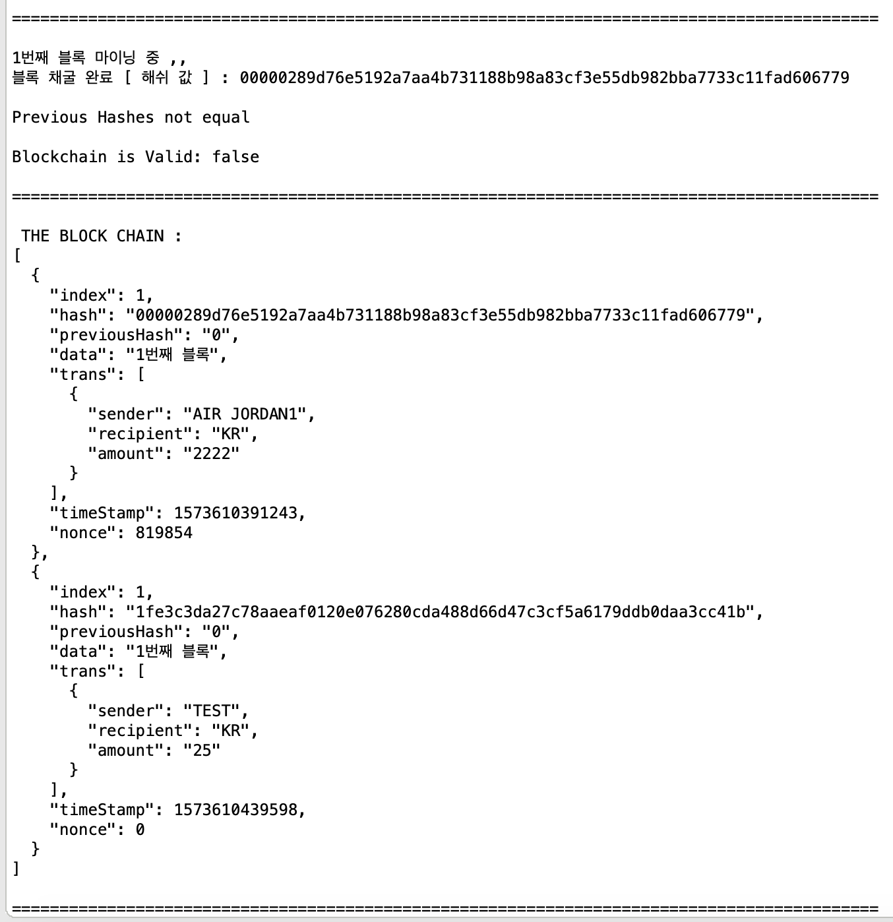

Slide 5
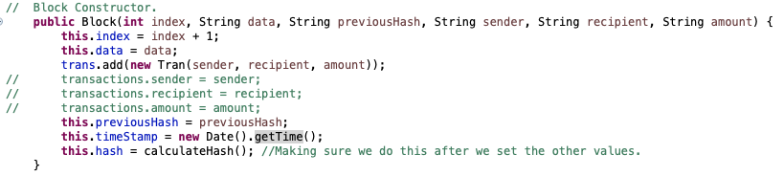

Slide 6
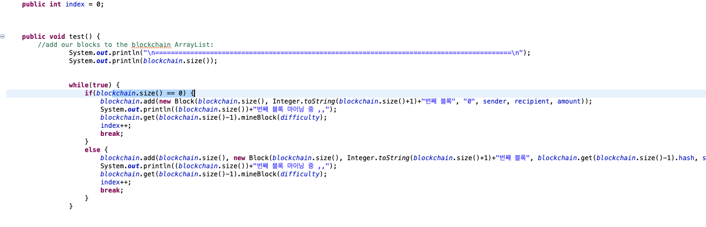

Slide 7
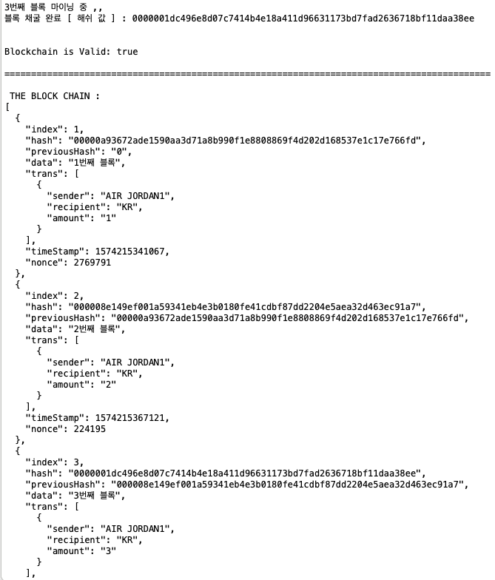

Slide 8
차주 계획
EVENT FIX

Slide 9
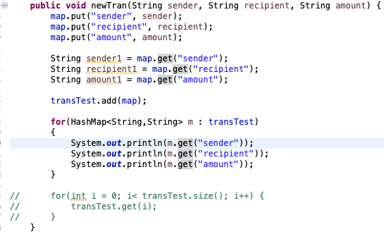

1

Slide 10
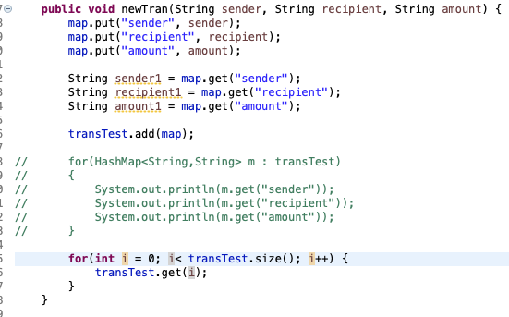
2

Slide 11
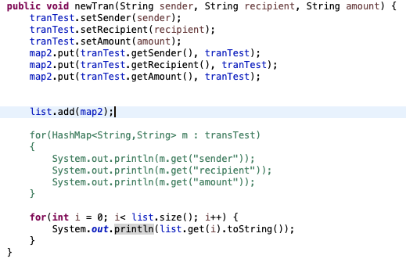
3

Slide 12
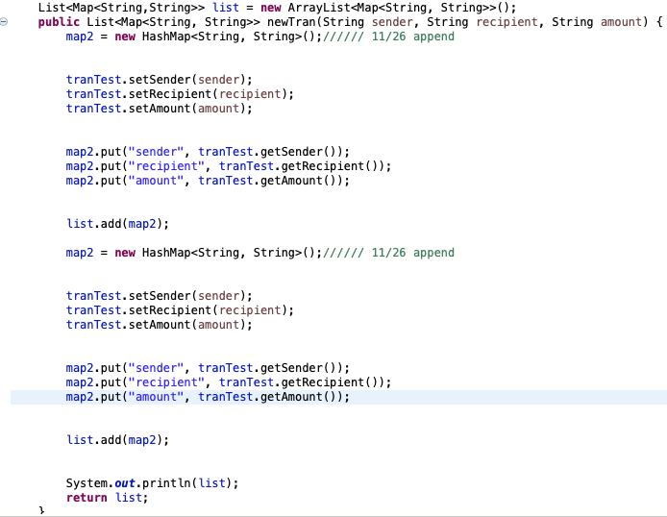
4

